Slide 1


ADVENTURE WORK ANALYSIS
P- Group 2 ( Project Team Members)
1.MEENU
2.NAVATEJA
3.SNAHESHA
4.HIREN
5.PUSHKAR
6. SANDESHA
7.SANDEEP

Slide 2

INDEX
INTRODUCTION
KPI -1 :Pivot table for Month and Sales
KPI -2 :Bar chart for Year wise Sales.
KPI -3 : Line chart for Month wise Sales.
KPI -4: Pie chart for Quarter wise sales.
KPI -5:Combinational chart for Sales Amount and Production cost
Dashboard.
Suggestions.

Slide 3
INTRODUCTION
About adventure work in short Adventure Works Cycles, the company on which the Adventure Works sample
databases are based, is a large, multinational manufacturing company. The company manufactures and sells metal and
composite bicycles to North American, European and Asian commercial markets. While its base operation is in Bothell,
Washington with 290 employees, several regional sales teams are located throughout their market base.
Coming off a successful fiscal year, Adventure Works Cycles is looking to broaden its market share by targeting their
sales to their best customers, extending their product availability through an external Web site, and reducing their cost
of sales through lower production costs.

Slide 4
Business objectives
The aim of this project is to analyze the Sales, Production cost, Profits, Customer and Unit
price and provide insights for developing effective retention strategies. Through data
analysis and visualizations, we will identify factors to improve the production.
To evaluate Yearly wise, Quarterly wise, Monthly wise Sales, Production and Profit.
To know where the lapses were.
Evaluate the effectiveness of existing strategies.
To verify the satisfaction level of customers in the organization.
Provide recommendations to improve Production.

Slide 5
KPI 1
Year | (All)
Row Labels | Sum of Sales
January | 2018058.487
February | 1884252.06
March | 2061276.182
April | 2104306.812
May | 2381564.483
June | 3171071.969
July | 2606019.047
August | 2904704.152
September | 2739697.174
October | 3149993.775
November | 3217775.107
December | 3468652.202
Grand Total | 31707371.45
MONTH WISE SALES WITH PIVOT TABLE :
By adding the year filter the month wise sales are analyzed. By that December have the highest sales with nearly 3.46M.
The grand total of the sales is 31.71M.

Slide 6
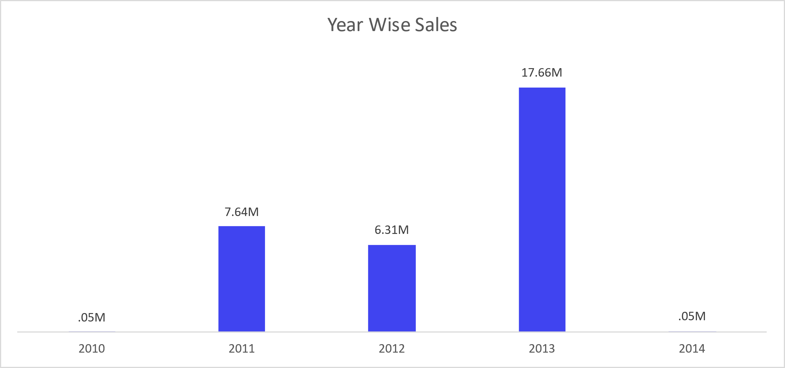
kpI 2
BARCHART YEAR WISE SALE
sales Amount started trending up on 2013,
rising by 17.66M in 4 years.﻿﻿﻿
Sales Amount jumped from .05 M to 17.66
during its steepest incline between 2010
and 2013.﻿﻿

Slide 7
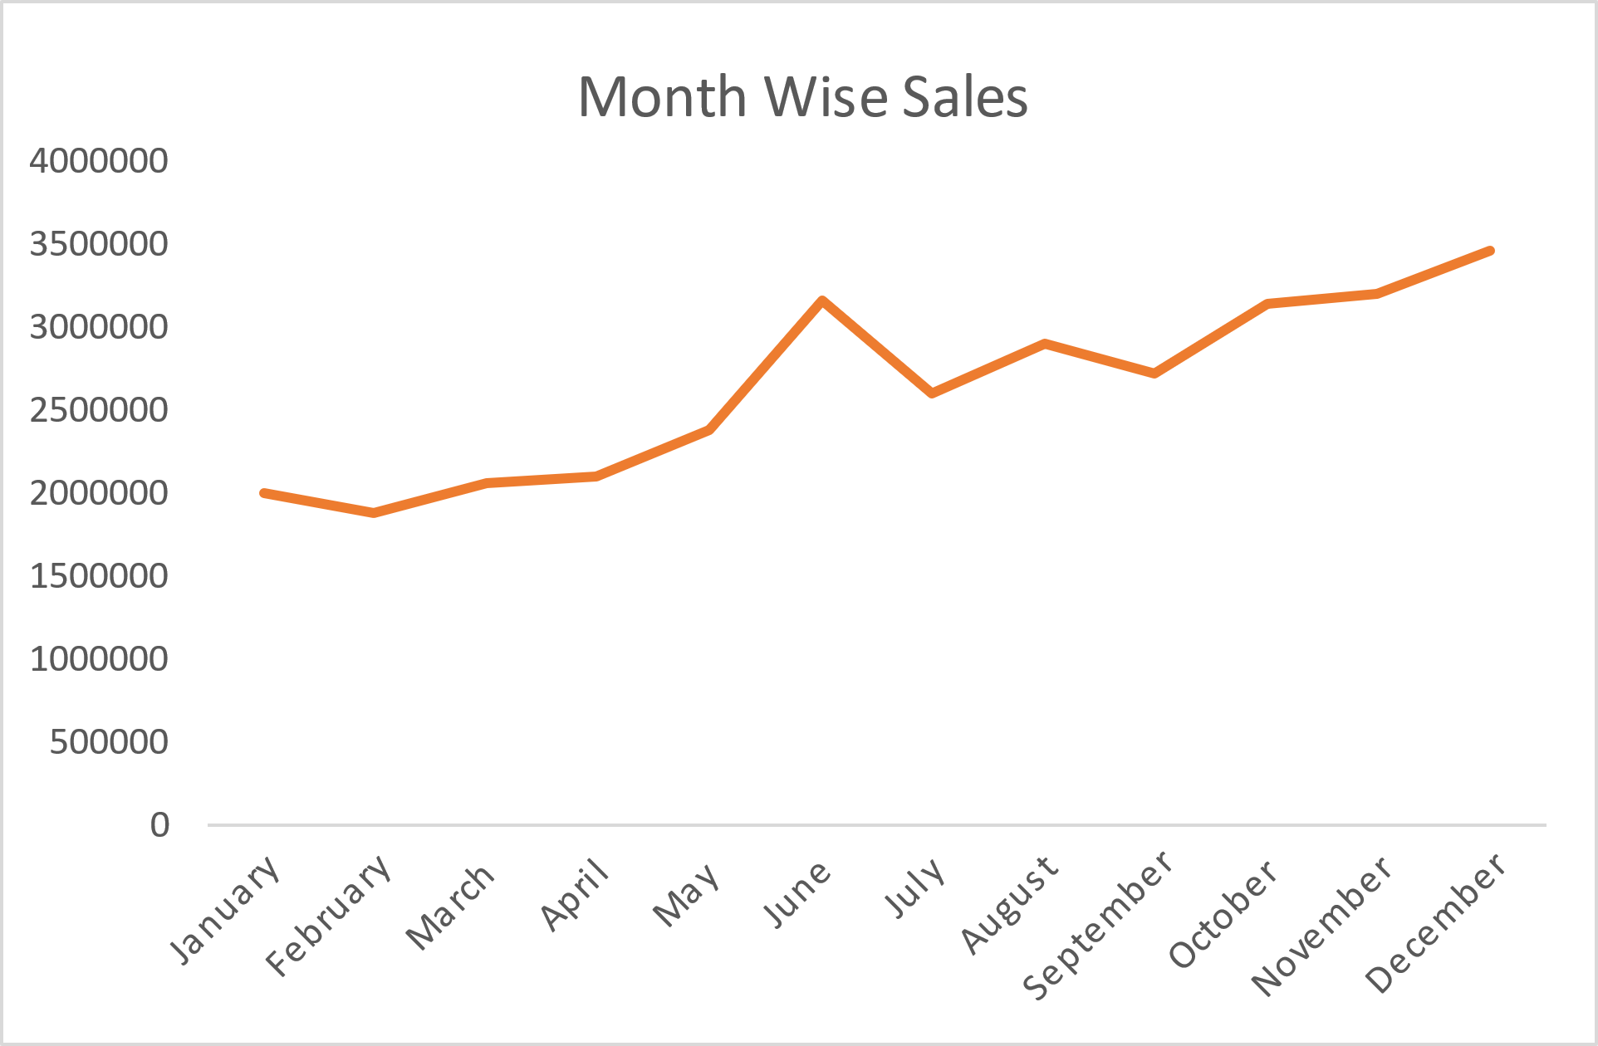
KPI3
Line chart for Month wise Sales.
Season of sale mainly starting from may till the year end December
Highest sales are of 3.46M in December
Second highest is in the month of June at an average of 3.2M

Slide 8
KPI4
Quarter wise sales
﻿Total quarter wise sales are as follows
Q1 19%
Q2 24%
Q3 26%
Q4 31 %
Q4 makes the highest sales in all over the FY﻿﻿

Slide 9
KPI5
Combinational chart for Sales Amount and Production cost
Sales and Production cost were high at FY13
﻿﻿In FY13 profit of 8.3 M profit generated
﻿At Across all 12 Month, sales ranged from 18M to 23 M in FY14.

Slide 10
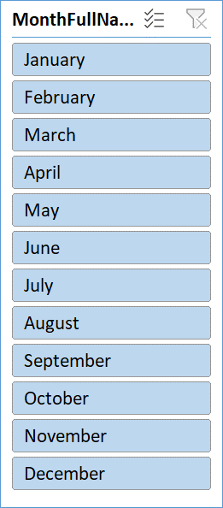



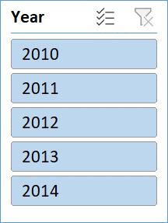

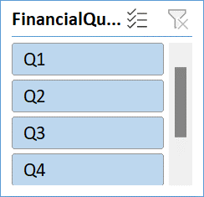

ADVENTURE WORKS
profit
sales
production
No.of orders
Tax

Slide 11
Year wise sale gradually increasing and need to maintain it and the sales and production were increasing from 2010 to 2013 and 2013 have highest sales and production. But comparatively the sales and production should raise from 2013 to 2014.
The sales and production should be increased even though the company was in profits.
The lapses should be noted down and should be taken care.
Need to focus on the products with low sales.
Q3,Q4 has the high potential than Q1,Q2 focusing more on and implementing new strategies in Q3,Q4 will result high conversion rate. If we focus other with new strategies in Q3,Q4 we will turn up with good result.
Maintain constant growth wit the other quarters of the year
SUGGESTIONS

Slide 12

Thankyou

